Slide 1
A Major Project On
Crop Yield Prediction
Coordinator : Dr. G. Sai Chaitanya Kumar Presented By
Guide : Mr. CH. Vinay Santhosh Batch No : C10
M. Sowmya Sree (18H71A05G4)
K. Hima Soundarya (18H71A05D6)
S. Akhila (18H71A05C1)
A. Sai Samanth (18H71A05F9)

Slide 2
Introduction
More than 50% of India's population are dependent on agriculture for their survival.
Most of the agricultural crops are being badly affected in terms of their performance over a period of the last two decades.
Agricultural crop prediction depends on biology, climate , economy , geography.
Crop yield is central to addressing food security challenges.

Slide 3
So, to get rid of these problems we intended to build a model for predicting crop yield using machine learning algorithm, that is Random Forest.
The prediction made by machine learning algorithms will help the farmers to come to a decision which crop to grow to induce the most yield.
The prediction is based on analyzing a static set of historical data.
The Application which we developed, runs the algorithm and shows the list of crops suitable for entered data with predicted yield value.

Slide 4
Problem Statement
Agriculture plays a critical role in the global economy.
Crop yield prediction is an important agricultural problem.
The Agricultural yield primarly depends on weather conditions(rain,temperature,etc).
Accurate information about history of crop yield is important.
To make decisions related to agricultural risk management and future predictions.

Slide 5
Motivation Problem
Healthy Existence of agriculture
World’s food Demands
Supporting farmers
Recommend the crop based on the factors

Slide 6
Literature Survey
Title and Name of the Author | Name of the journal and year | Algorithms/Technique used | Advantages | Disadvantages
Crop yield prediction using machine learning. M S Minu Sanju Dharan Christo Immanuel Deepak | SRM University of Science and Technology 2020 | Random Forest ,K Nearest Neighbor, Hadoop | The web application likewise gives a discussion to the ranchers to stock the merchandise without mediators. | KNN Algorithm Sensitive to noisy and missing data.

Slide 7
Title and Name of the Author | Name of the journal and year | Algorithms/Technique used | Advantages | Disadvantages
Agro-genius : Crop Prediction using Machine Learning Anjalie Gamage Puvipavan Palendrarajah | Sri Lanka Institute of Information Technology Oct 2019 | Multiple linear regression and ARIMA Model | Recommends crop harvesting duration. Currently cultivated crop which are updated biweekly. | Limited data is used
Title and Name of the Author
Name of the journal and year
Algorithms/Technique used
Advantages
Disadvantages

Slide 8
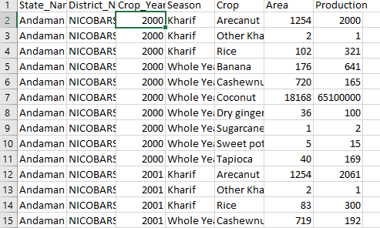
Dataset
Dataset is taken from Kaggle

Slide 9
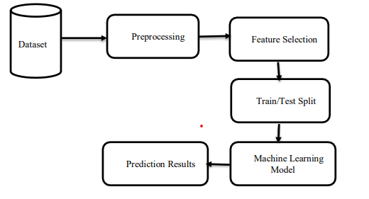
Architecture Diagram

Slide 10
Methodology Data exploration
The first step is Data Collection
We require two datasets, one for predicting the yield algorithm and other for crop recommendation.
Statistical information is collected from Kaggle.
Dataset have about 250000 instances.

Slide 11
Data Pre-Processing
In data pre-processing, we import required packages
Read the dataset and drop the unnecessary columns and check whether null values are present in our data.
Categorize data for training and testing.

Slide 12
Proposed System
We intend to build a machine learning model with Random Forest algorithm to provide high accuracy.
Random Forest: It is a supervised learning algorithm, is based on the concept of ensemble learning, which is a process of combining multiple classifiers to solve a complex problem and to improve the performance of the model.

Slide 13
Advantages
Better Accuracy
Can work with large dataset
Multiple decision trees are trained parallelly for prediction.
Possibility of overfitting is low.

Slide 14
Technologies
Software Requirements:
Operating System : Windows 7 and above
Platform: Google Colab
Programming Language : Python
Framework : Flask

Slide 15
Hardware Requirements:
Processor : I3 Onwards
RAM : 2 GB
Hard disk : 128 GB

Slide 16
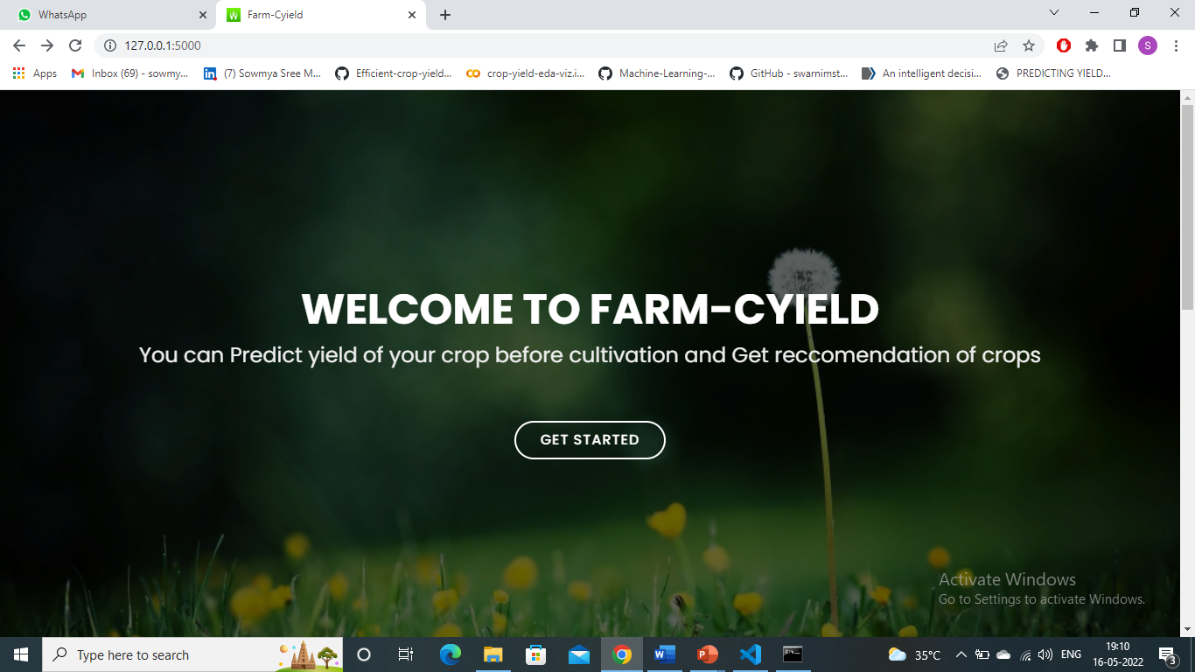
Output Screens Home Page

Slide 17
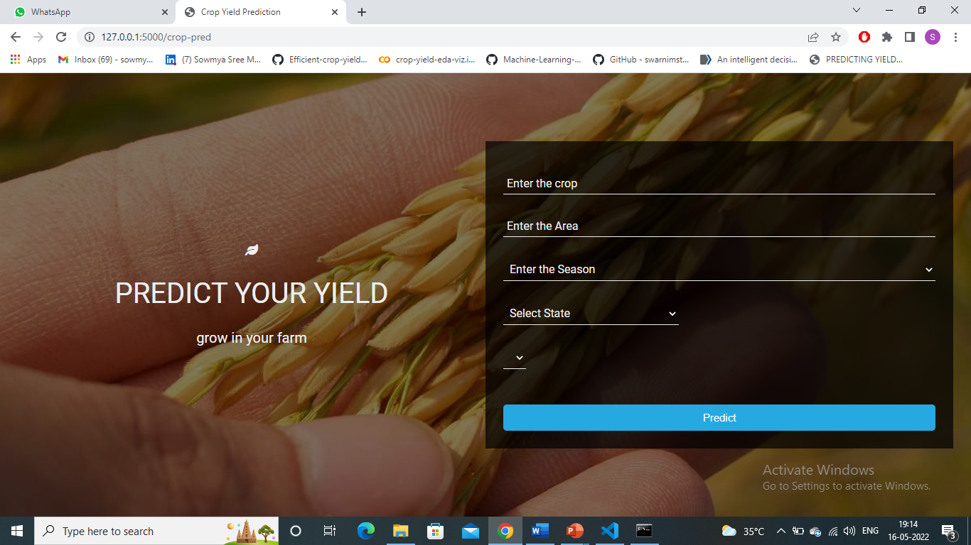
Yield Prediction Page

Slide 18
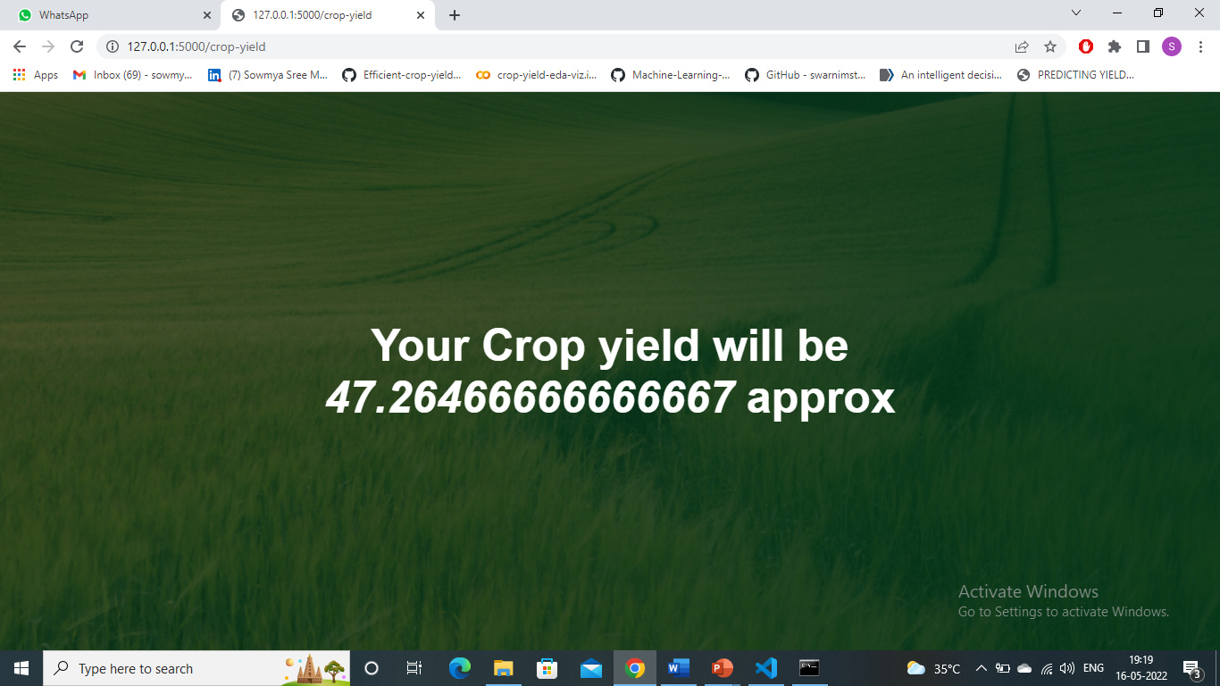
Yield Prediction Output Page

Slide 19
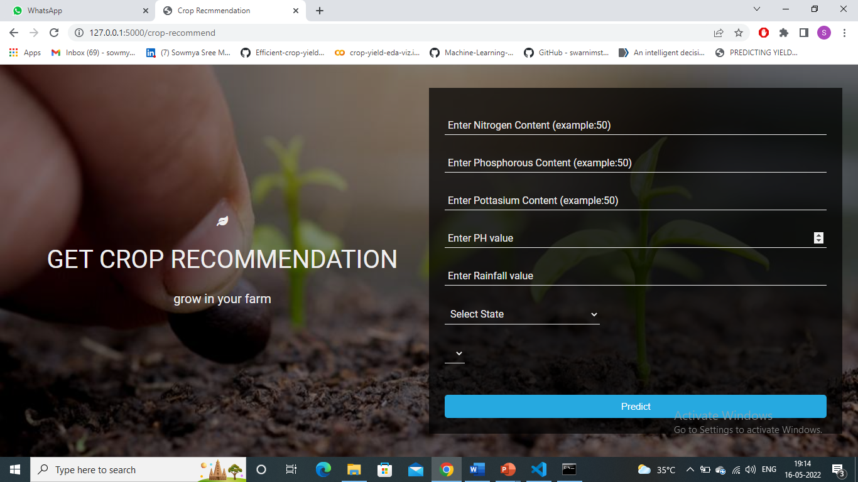
Crop Recommendation Page

Slide 20

Crop Recommendation Output Page

Slide 21
Conclusion
Now-a-days, farmers facing so many challenges due to variations in weather, climate, and other such environmental conditions have become a major risk for the healthy existence of agriculture.
To solve these challenges and get rid of these problems we intended to build a good model for predicting crop yield using machine learning algorithms, those are linear regression, Random Forest.
By this model we can predict the yield of a crop by considering the soil type, crop type and other factors.

Slide 22
References
Keita, N. Improving cost-effectiveness and relevance of
agricultural censuses in africa: Linking population and
agricultural censuses, 2018.
Keita, N. Improving cost-effectiveness and relevance of
agricultural censuses in africa: Linking population and
agricultural censuses. 04 2019.
Kuwata, K. and Shibasaki, R. Estimating crop yields with
deep learning and remotely sensed data. In Geoscience
and Remote Sensing Symposium (IGARSS), 2015 IEEE

Slide 23
Limitations
Not suitable for linear methods
Large number of trees can make the algorithm slow.
Sparse data can alters the ability to calculate accurate predictions

Slide 24
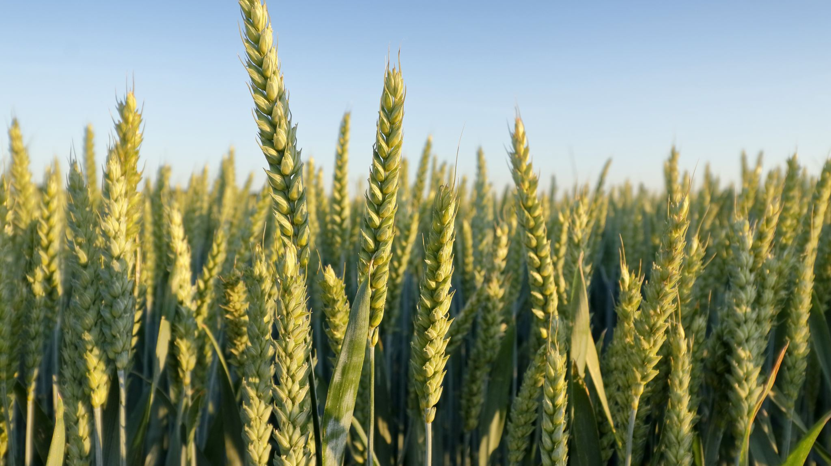
Thank You

